Slide 1
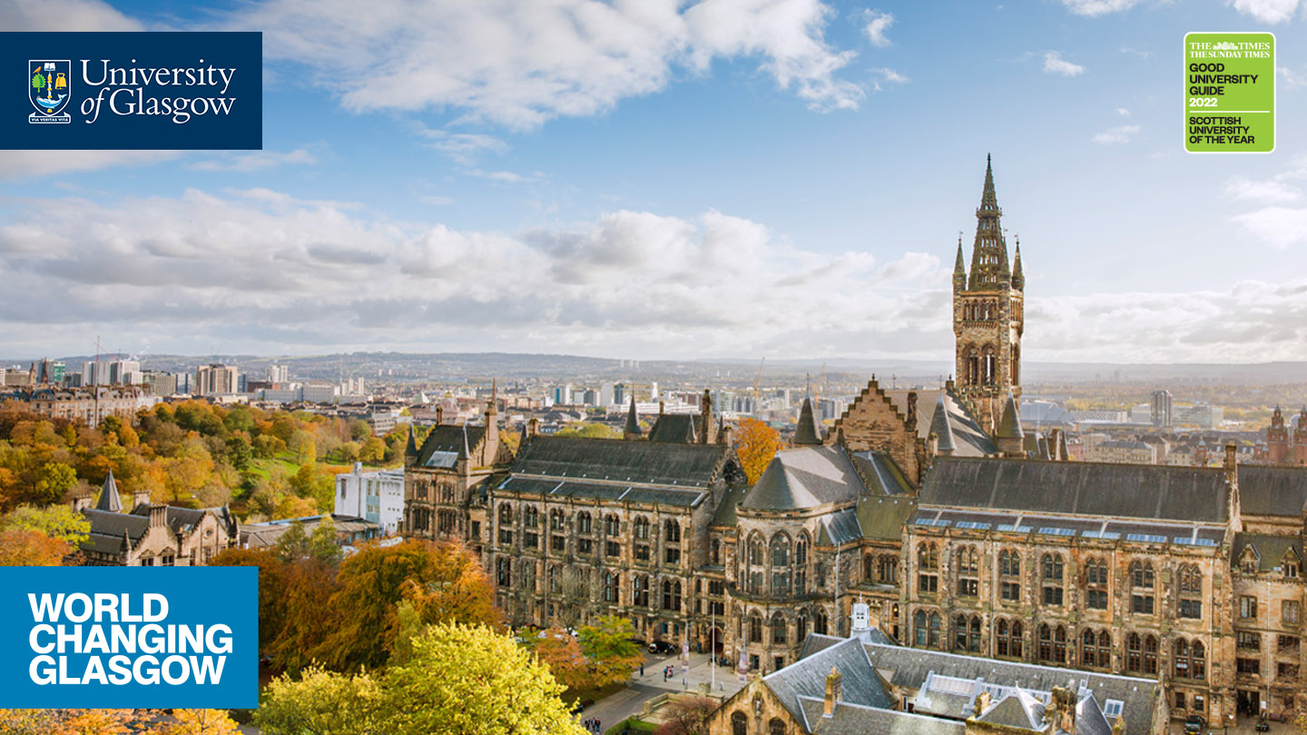
Professor David Flynn
Variables and Operators - EN2083

Slide 2
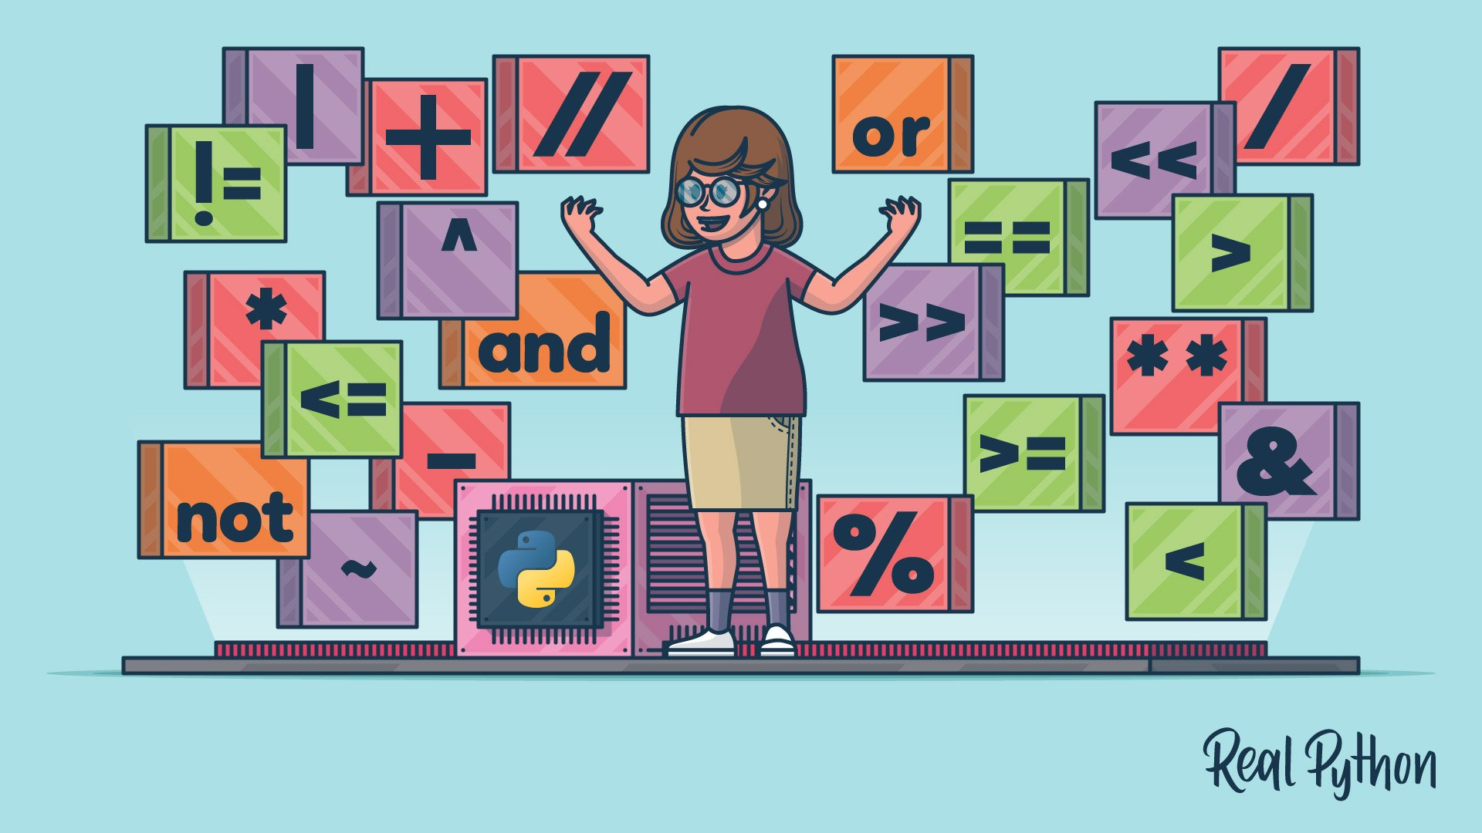
Variables & Operators
(including input and output)
(thanks to Dr Scott Roy for these materials)
Most of the operators for python…

Slide 3
Variables
(making memory memorable)
Example: 3 Apple in the Basket
value
variable

Slide 4
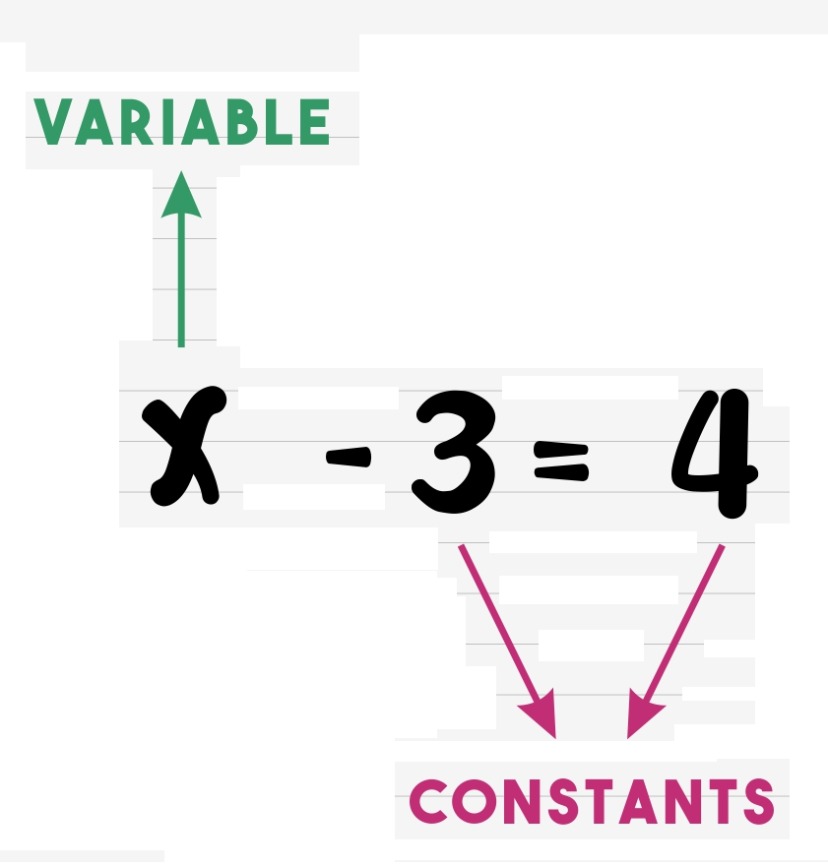
First non-Variables
Literal constants are just constants, literally!
-7, 7.2, 16E-10, 3j, True,...
Python decides on whether these are integers, floating points or Booleans and organises memory storage appropriately.
'Fred', "Fred", """Fred
Fred""",...
string constants: triple quotes for multi-line
Notes:
Variables are variable! No real computing reason to have a constant specified differently, it’s all going to be a location in memory - but C does allow constants, and their definition is mainly designed so that the compiler can warn you when you are doing something wrong, like trying to change a constant.

Slide 5
Variables
An alias to the value in a memory location.
Variable names should be meaningful : myAge, initial_speed, profit
  makes code understandable; sharpens thinking
Actual location in physical memory chosen by the operating system, and can change.
Can extract an address of the memory location, using id(myAge) in CPython
Notes:
Variables are variable! No real computing reason to have a constant specified differently, it’s all going to be a location in memory - but C does allow constants, and their definition is mainly designed so that the compiler can warn you when you are doing something wrong, like trying to change a constant.

Slide 6
Variable Names
Robot_Name1
≠
robot_name1
≠
robot_Name1
≠
Robot_name1
made up of letters, digits, and underscore
case sensitive
first character must be a letter or underscore
Python keywords (if for, etc.) barred
don’t use obviously confusing names (i.e. l, lower case L) unless you’re obfuscating.
Ensure the same spelling and exact capital letters
As a note from Daniel the PhD student this is my
most common problem in my code 9 times out of 10 when debugging

Slide 7

Creating variables
usually created due to an assignment, resulting from evaluation, constant or value of another variable. i = 7
RHS is evaluated, then assignment performed. “eye becomes equal to seven”
Python brings them into existence when they need to be used (unlike other languages) which keeps things clean!
Try to ensure you create variable names that are clear.
Always think, would this name be clear in a week once I’ve not looked at my code in a while?

Slide 8
Updating variables
a = c another variable
a = 5 a constant
a = a + 1 evaluation (RHS first)
a = j*a evaluation (RHS first)
a = b = c = 0 multiple to value
a,b,c = -7, 3, 2 multiple to values

Slide 9
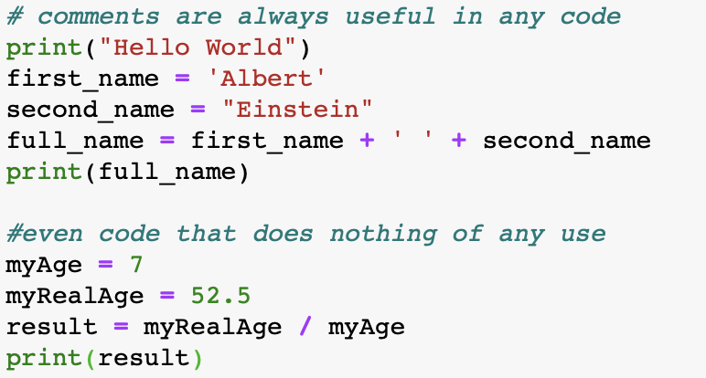
Example Code
Notice the “first_name” variable name is same everywhere
Notes:
try short long and double as well
mention the odd way that printf works, and that there will be more detail later

Slide 10
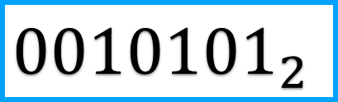
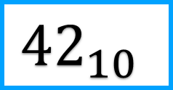
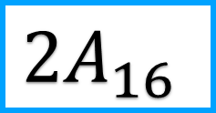
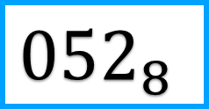
Units !
integer in decimal ; 42
integer in hexadecimal; 0x2A
integer in octal; 052
integer in binary ; 0b00101010
$${42}_{10}$$
$${0010101}_{2}$$
$${052}_{8}$$
$${2A}_{16}$$

Slide 11
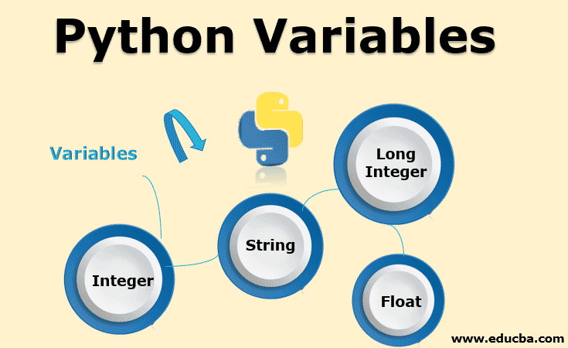
Variables are Objects !
Every variable in Python (integers, floating point numbers, strings) are actually objects.
Objects hide useful metadata (for instance the length of a string, so that the system never over-runs when processing).
Therefore can do x = None, or del x, to make a variable undefined, or to zap it.

Slide 12
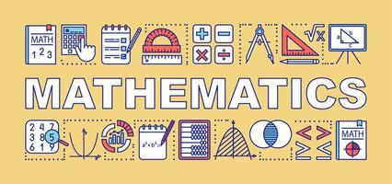

Operators
(using variables - manipulating data - mostly maths)
Think about it as a pathway from calculators to beyond where you can manipulate data rapidly and complete multiple calculations at once

Slide 13
Using Variables
+
Each program is a sequence of variable modifications - that’s what an algorithm is
Modifications happen due to operators,
e.g. + - / *, etc.
There are more advanced operators, short cuts, and functions provided in libraries.
You will also write your own functions.
Oh, strings are immutable - can't change 'em
-
/
*
<
&
~
Notes:
Idea of functions hiding previous work to simplify code should be introduced here.

Slide 14
Operators
four basic: + - / *
maths works like you'd expect !
12/5 → 2.4, 5/9 → 0.55555... precision?
integer division and modulo operator: // %
gives the integer and remainder after division, so 12//5 → 2, 5%9 → 5

Slide 15
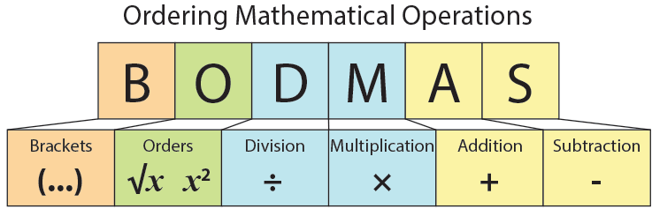
Operator Precedence
always use brackets if even vaguely unsure.
works the same way as normal mathematics where */% take precedence over +-. Within each group precedence is typically left to right.
Precedence is important to get the right results.
Notes:
flag up that right results include the right effects of rounding and machine precision in floating point numbers, and that this can be important.

Slide 16
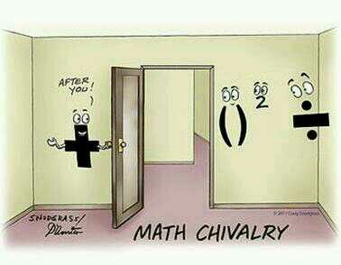
Operator Precedence
An example :
a+b*c*d%e - f/g
5 1 2 3 6 4
a + ( (b*c*d)%e ) - (f/g)
4. Addition
1. Brackets
2. Order
3. Division
The order of operators through the door according to BODMAS

Slide 17
Operator Precedence
Another example :
a*(b+c)%5+x/(3+p)-r-j
(b+c) and (3+p) first due to brackets. If all of the variables are integers, the brackets will be too.
multiplication, then modulo, then division.
finally additions and subtractions L →R.

Slide 18
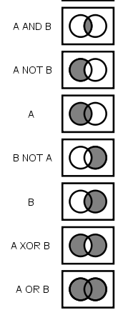
Logical Operators
Boolean / Relational / Logical variables can have two values {True, False}.
Actually, you tend not to explicitly create names variables which are Boolean
This doesn’t stop you using logical operators, however…

Slide 19
Logical Operators
operator | description
not | NOT, unary logical negation
<, <=, >, >= | comparisons (note order)
==, != | is equal, not equal in value
and | AND
or | OR
is, is not | is the same, not the same object
logical operators return False,True
make sure and/or applied to Booleans !
Notes:
Make clear that = and == are NOT the same thing.
If you use non-Booleans for and/or then effectively 0 is counted as false, anything else is counted as true, and if the outcome is true you use the second variable and if the outcome is false you use the first.

Slide 20
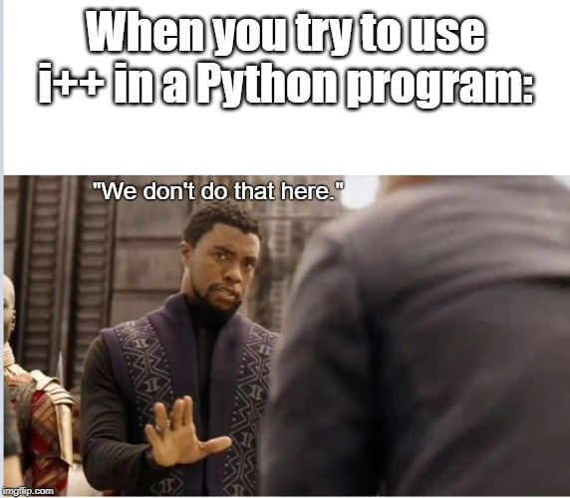
Short Cut Operators
A shortcut style, arises from the fact that n=n+10; is a very common form.
The shortcut is n+=10;
Most of the common mathematical operators can have the same shortcut:
+=, -=, *=, /=, //=, %=
This is a C++ joke
Notes:
I usually write these out in full just to make it clear to myself what’s going on.
Make it clear that all these shortcuts have to be learned, because that’s what programmers commonly use, even if you decide not to use them yourself.

Slide 21
But conversion?
Python works out the variable type from how it's used.
What if you want another type. Need inbuilt conversion functions.

Slide 22
But conversion?
int("15") is 15
int("15.7") is 15
int("3f",16)is 63 (translate from hex)
float("-11.28E1") is -112.8
round("15.11",0) is 15
round("15.11",1) is 15.1
bool(x) is True if x 'exists'
Notes:
Note 'exists' means an empty sequence is passed, such as (), [], ”, etc, or x=None, or x is a numeric value of 0, 0.0.

Slide 23
useful conversions
oh and str(15.11) is '15.11'
and if z=3+2j, then z.real is 3 and z.imag is 2
… there are more advanced operators, short cut operators, and functions provided in libraries (like id())

Slide 24
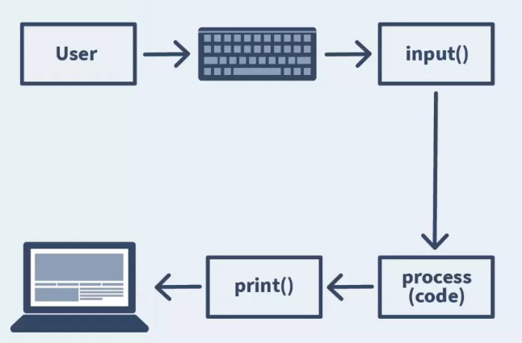
Input/Output
(print and input library functions + formatting)

Slide 25
Input / Output
One of the messiest bits of many programming languages
input and output date from a time when dot matrix line printers were cool
and output often needs to constrain numbers into neat columns for printing.

Slide 26
Input / Output
print(“hello world”)
age=7
print('age='+str(age))
using string concatenation will work but isn't very powerful.
Reminder: The operation of joining two strings together

Slide 27
Output
print(“My Text {} {} {}”.format(var1, var2, var3)
is how we go about doing it more usefully, with, in this case, three variables.
Python prints the initial My Text, and then substitutes each variable into the specification - the { }.

Slide 28
Output
  The specification {} can be more complicated: {<select>:<format>}
  <select> is just the number of the variable in the variable list (counting from zero), so the following are identical
print(“{}{}”.format(v1,v2))
print(“{0}{1}”.format(v1,v2))

Slide 29
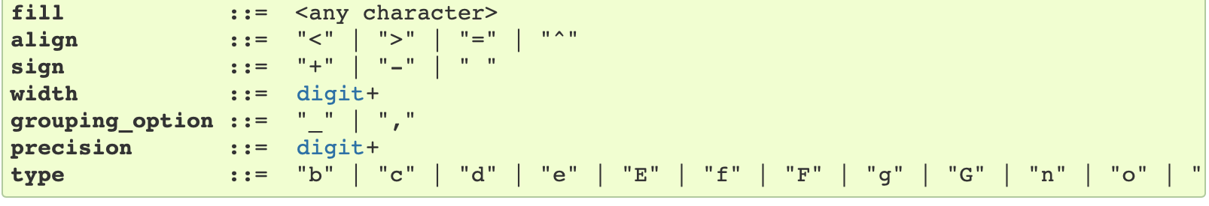
Output
  <format> is much worse !
  <fill><align><sign><#><0><width><grouping><.precision><type>

Slide 30
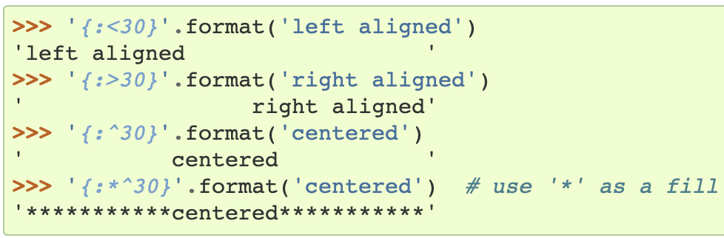
Clearer with Examples
Notes:
if you swap y and x then the system will give you a warning and try and do the best it can
flag what happens if the format is too small for the number

Slide 31
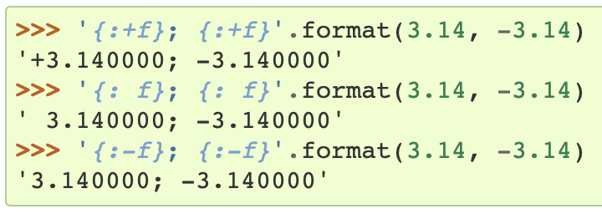
Clearer with Examples
Notes:
if you swap y and x then the system will give you a warning and try and do the best it can
flag what happens if the format is too small for the number

Slide 32
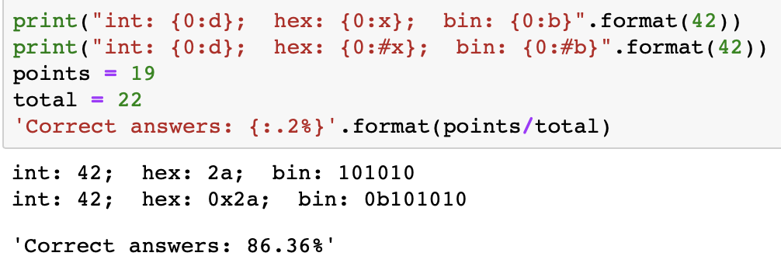
Clearer with Examples
Notes:
if you swap y and x then the system will give you a warning and try and do the best it can
flag what happens if the format is too small for the number

Slide 33
Finally on print
print always ends with an invisible newline character '\n'
you can suppress this by saying print('stuff', end='')
Other useful invisible characters are \t for a tab, \' and \" for single and double quotes, and \\ for a backslash.
Print is used when you want to display different values or text.
E.g. you may need your code do do several calculations and you can get your code to ’print’ the values of each calculation
You will need this for a lot of the labs

Slide 34
Input
s = input(“Question?”)
Much easier. You always input a string.
Then, of course, you have to use a bunch of conversion functions to get the numbers you want from this string.
ans = int(s)

Slide 35
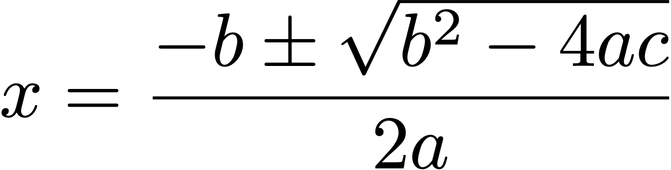
Summary Example
(roots of a quadratic equation)

Slide 36
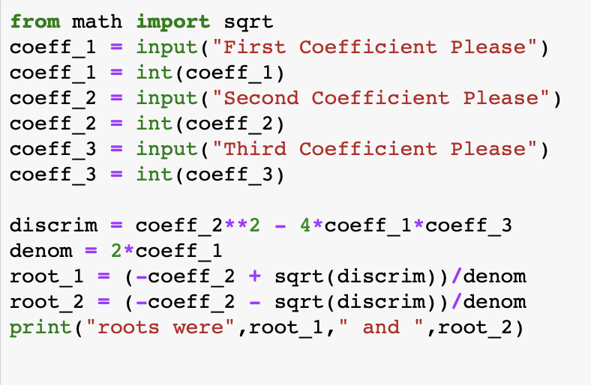
Summary Example
Notes:
if you swap y and x then the system will give you a warning and try and do the best it can
flag what happens if the format is too small for the number

Slide 37
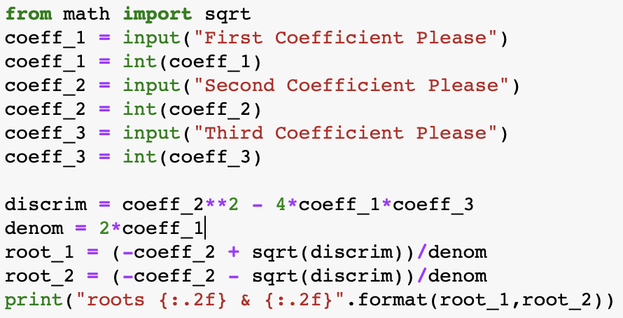
Summary Example
Notes:
if you swap y and x then the system will give you a warning and try and do the best it can
flag what happens if the format is too small for the number

Slide 38
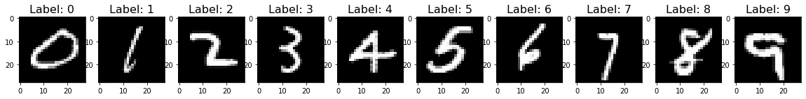
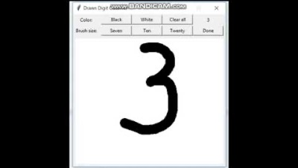
Harnessing Machine Learning and AI for Handwritten Digit Recognition with Python
In the dynamic world of artificial intelligence and machine learning, Python serves as the gateway to crafting a code that can identify handwritten digits.
How it Works:
Train our machine learning algorithm using an extensive dataset. Imagine teaching our digital companion the intricate nuances of each handwritten digit. To illustrate, we expose it to countless images of the digit '1', patiently guiding it through the distinctive features that define a '1'. Through this meticulous training, our machine transforms into a perceptive expert.
Now, whenever our machine encounters a handwritten '1'—be it a scrawl on a piece of paper or a pixelated image on a screen—it possesses the ability to distinguish it from other digits, like '2’.
Now its capable of unravelling the mysteries of handwritten numbers. This remarkable achievement exemplifies the synergy of human intelligence and artificial intelligence, showcasing how Python empowers us to bridge the gap between the analogy and digital worlds.

Slide 39



Thank you
#UofGWorldChangers
@UofGlasgow

